Slide 1
CN Lab
Assignment-6

Slide 2
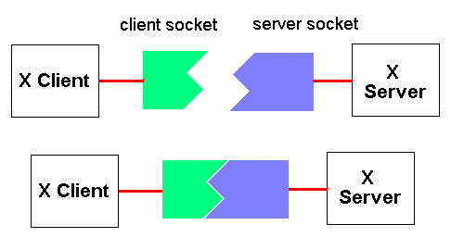
What is a Socket and Socket Programming?
An interface between an application process and transport layer
The application process can send/receive messages to/from another application process (local or remote)via a socket
Work very similar to files.
Socket programming is a way of connecting two nodes on a network to communicate with each other.
Server - forms the listener socket
Client - reaches out to the server

Slide 3
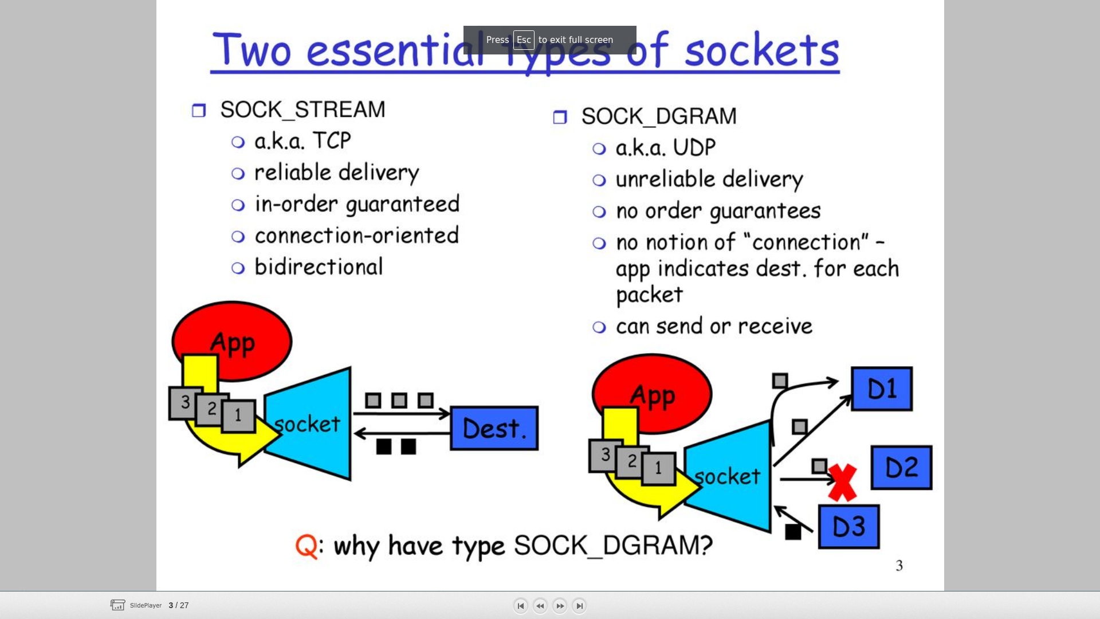
Types of socket
SOCK_STREAM
TCP
Reliable delivery
In-order guaranteed
Connection-oriented
bidirectional
SOCK_DGRAM
UDP
Unreliable delivery
No order guaranteed
Connection-less
Can send or receive
Other types, beyond the scope of the present discussion
RAW sockets
SPS - Sequenced Packet sockets

Slide 4
Basic Idea
When two processes located on the same or different machines communicate, we define association and socket.
– Association: basically a 5-tuple
• Protocol
• Local IP address
• Local port number
• Remote IP address
• Remote port number
– Socket: also called half-association (a 3-tuple)
• Protocol, local IP address, local port number
• Protocol, remote IP address, remote port number

Slide 5
The Client and Server model
Server - an entity which is a provider of information
Client - an entity which is a seeker of information
The Server starts up first and wait for client to connect to it
After a Client successfully connects, it requests some information
The Server serves the informations to the client.
The client then disconnects.
Server waits for more clients.

Slide 6
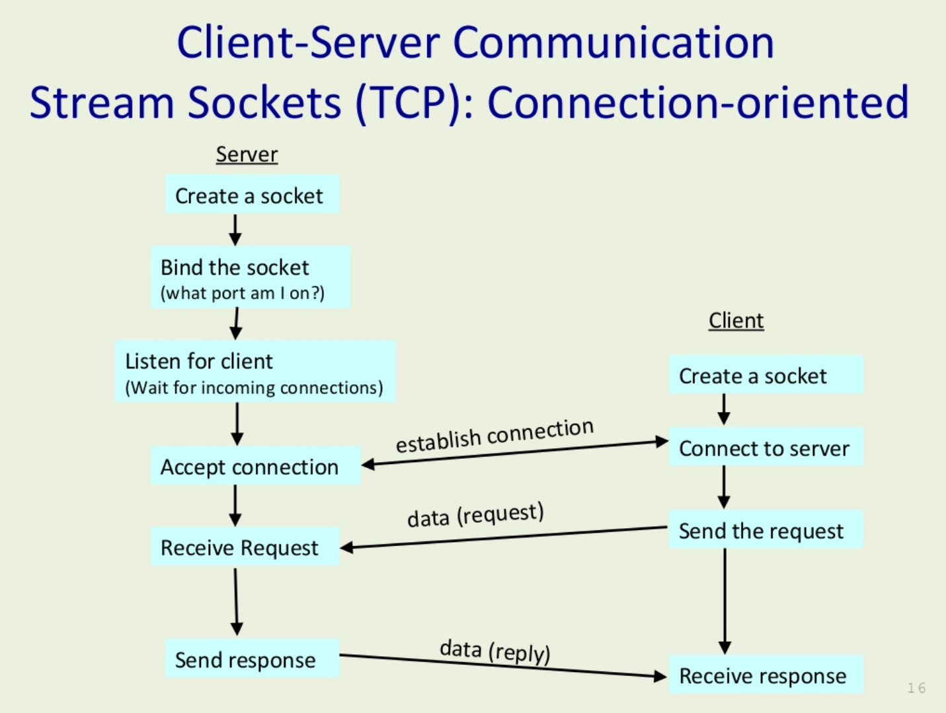

Slide 7
Systems calls for using sockets
socket()
bind()
connect()
listen()
accept()
send() & recv()
sendto() & recvfrom()
close() & shutdown()
getpeername()
gethostname()
gethostbyname()

Slide 8
Socket Creation in C
creates an endpoint for communication and returns a file descriptor that refers to that endpoint
int sck = socket(domain, type, protocol);
Parameters
sck - socket descriptor (-1 on error), an integer (like a file handler)
domain: Communication domain
AF_UINIX: uses Unix pathnames to identify sockets and very useful for IPC.
AF_INET: uses IP address
type : Communication type
SOCK_STREAM
SOCK_DGRAM
protocol: specifies protocol, usually set to 0.
Returns file descriptor on success, on error -1
Example:
server_fd = socket(AF_INET, SOCK_STREAM, 0)

Slide 9
bind() - Attaching to an IP and Port
A server process call bind to attach itself to a specific port and IP address
int bind(int sockfd, struct sockaddr *my_addr, socklen_t addrlen)
Parameters
sockfd = socket descriptor returned by socket()
my_addr = pointer to a valid sockaddr_in cast as a sockaddr * pointer
addrlen: typically set to sizeof(struct sockaddr)
Returns 0 if it successfully binds to the address, otherwise it returns -1 on error.
Example:
struct sockaddr_in address;
address.sin_family = AF_INET;
address.sin_addr.s_addr = INADDR_ANY;
address.sin_port = htons( PORT );
bind(server_fd, (struct sockaddr *)&address, sizeof(address))

Slide 10
listen() - wait for a connection
listen() - The server process calls listen to tell the kernel to initialize a wait queue of connections for this socket.
int listen(int sock, int backlog)
Parameters:
sock = socket returned by socket()
backlog = Maximum length of the pending connections queue.
Returns 0 on success, otherwise it returns -1 on error.
Example:
listen(server_fd, 3)
select() - Select command allows to monitor multiple file descriptors, waiting until one of the file descriptors become active. A better way to handle multiple client.
ready = select(nfds, &readfds, &writefds, &exceptfds, timeout);
Parameters:
nfds is the highest-numbered file descriptor
readfds - checks to see if any sockets are ready for reading
writefds - checks to see if any sockets are ready for reading
exceptfds - checks to see if any sockets have an exceptional condition pending. Out of scope for this assignment.
timeout - timeout value
Returns number of ready socket descriptor.

Slide 11
accept - A new connection
Accept is called by a server process to accept new connections from new clients trying to connect to the server.
int accept(int socket, (struct sockaddr *)&client, socklen_t *client_len)
Parameters:
socket = the socket in listen state
client = will hold the new client’s information when accept returns
client_len = pointer to size of the client structure
Returns a non-negative descriptor on success, otherwise it returns -1 on error.
Example:
new_socket = accept(server_fd, (struct sockaddr *)&address, (socklen_t*)&addrlen)

Slide 12
connect() - connect a service
Connect is called by a client to connect to a server port.
int connect(int sock, (struct sockaddr *)&server_addr, socklen_t len)
Parameters:
sock = a socket returned by socket()
server_addr: a sockaddr_in struct pointer filled with all the remote server details and cast as a sockaddr struct pointer
len: size of the server_addr struct
Return -1 when connect fails
Example:
connect(sock, (struct sockaddr *)&serv_addr, sizeof(serv_addr))

Slide 13
send() / recv()
send() - is used to send data over stream sockets or CONNECTED datagram sockets.
int send(sockfd, &buf, len, flags);
Parameters:
sockfd -socket descriptor returned by socket()
buf - pointer to the data you want to send
len - length of the data you want to send
flag - typically set to false
This call returns the number of bytes sent out, otherwise it will return -1 on error.
recv() - is used to receive data over stream sockets or CONNECTED datagram sockets
int recv(int sockfd, void *buf, int len, unsigned int flags);
Parameters:
sockfd -socket descriptor returned by socket()
buf - pointer to the data you want to send
len - length of the data you want to send
flag - typically set to false
This call returns the number of bytes read into the buffer, otherwise it will return -1 on error.

Slide 14
sendto() / recvfrom()
sendto() - is used to send data over UNCONNECTED datagram sockets.
int sendto(int sockfd, const void *buf, int len, unsigned int flags, const struct sockaddr *to, int tolen);
Parameters:
sockfd -socket descriptor returned by socket()
buf - pointer to the data you want to send
len - length of the data you want to send
flag - typically set to false
to - pointer to struct sockaddr for the host where data has to be sent.
tolen - typically set to zero
Returns the number of bytes sent, otherwise it returns -1 on error.

Slide 15
sendto() / recvfrom() - continued...
recvfrom() - is used to receive data from UNCONNECTED datagram sockets.
int recvfrom(int sockfd, void *buf, int len, unsigned int flags struct sockaddr *from, int *fromlen);
Parameters:
sockfd -socket descriptor returned by socket()
buf - pointer to the data you want to send
len - length of the data you want to send
flag - typically set to false
from − It is a pointer to struct sockaddr for the host where data has to be read.
fromlen − It is set it to sizeof(struct sockaddr).
Returns the number of bytes read into the buffer, otherwise it returns -1 on error.

Slide 16
close and shutdown
close() - used to close the communication between the client and the server
int close( int sockfd );
Parameters
sockfd − It is a socket descriptor returned by the socket function.
Returns 0 on success, otherwise it returns -1 on error.
shutdown() - is used to gracefully close the communication between the client and the server. This function gives more control in comparison to the close function.
int shutdown(int sockfd, int how);
Parameters
sockfd − It is a socket descriptor returned by the socket function.
how − Put one of the numbers −
0 − indicates that receiving is not allowed,
1 − indicates that sending is not allowed, and
2 − indicates that both sending and receiving are not allowed. When how is set to 2, it's the same thing as close().
Returns 0 on success, otherwise it returns -1 on error.

Slide 17
getpeername()
getpeername() - retrieves the peer address of the specified socket.
int getpeername(int s, struct sockaddr *name, socklen_t *namelen);
Parameters:
s - returns the name of the peer connected to socket
name - information about the machine you're connected to
namelen - should be initialized to indicate the amount of space pointed to by name
Upon successful completion, 0 is returned. Otherwise, -1

Slide 18
Data structures
Let us now look at the data structures used to hold all the address Information:
Struct sockaddr {
unsigned short sa_family;
char sa_data[14];
}
Struct sockaddr_in {
short sin_family;
unsigned short sin_port; // Port Number
struct in_addr sin_addr; // IP Address
char sin_zero[8];
}
Struct in_addr {
unsigned long s_addr; // 4 bytes long
}

Slide 19
gethostname()
This function returns the name of the computer that your program is running on.
int gethostname (char *hostname, size_t size);
Parameters
hostname - pointer to an array of chars that will contain the host name upon the function’s return.
size - length in bytes of the hostname array.

Slide 20
gethostbyname()
gethostbyname()- returns the IP address of a given its name.
struct hostent *gethostbyname(const char *name);
struct hostent
{
char *h_name; /* official name of the host */
char **h_aliases; /* NULL terminate array of alternate names */
int haddrtype; /* Type of address being returned (AF_INET) */
int h_length; /* Length of the address in bytes */
char **h_addr_list; /* Zero terminated array of network addresses */
};

Slide 21
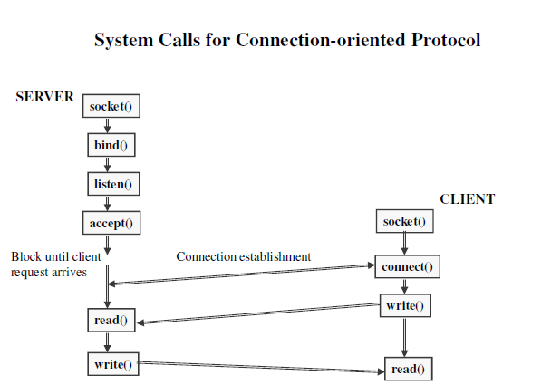
System calls for Connection-oriented Protocol

Slide 22
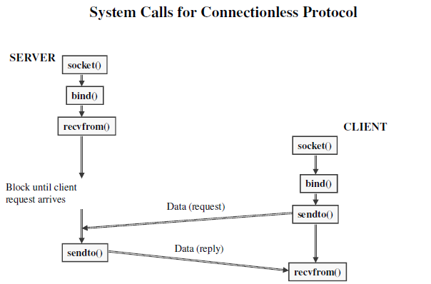
System calls for Connectionless Protocol

Slide 23
Thank you
Questions?

